Slide 1
Data
Compression
15.<number>

Slide 2
Objectives
After studying this chapter, the student should be able to:
Distinguish between lossless and lossy compression.
Describe run-length encoding and how it achieves compression.
Describe Huffman coding and how it achieves compression.
Describe Lempel Ziv encoding and the role of the dictionary in encoding and
decoding.
Describe the main idea behind the JPEG standard for compressing still
images.
Describe the main idea behind the MPEG standard for compressing video
and its relation to JPEG.
Describe the main idea behind the MP3 standard for compressing audio.

Slide 3
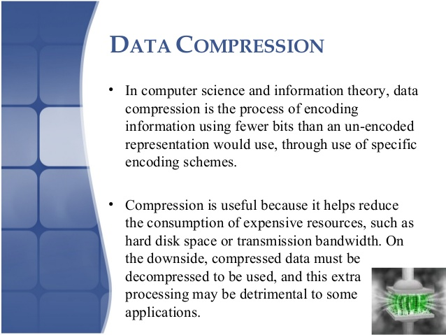


Slide 4
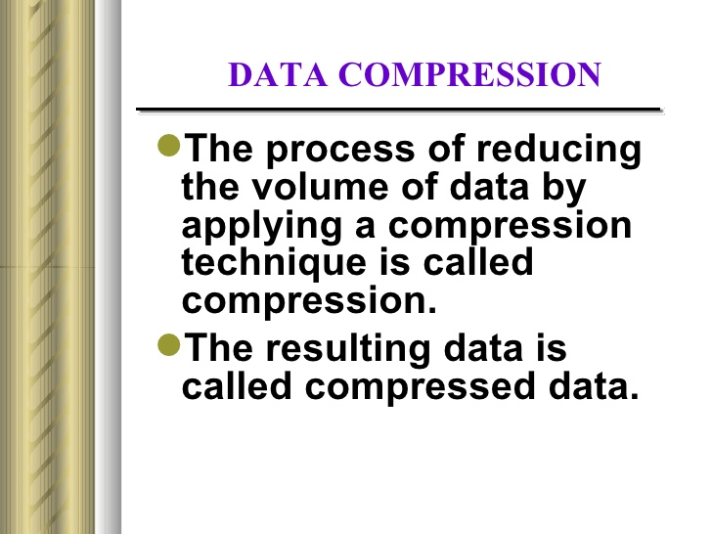

Slide 5
Audio Data Compression
Lossless Audio Compression
  Removes redundant data
  Resulting signal is same as original – perfect reconstruction
Lossy Audio Encoding
  Removes irrelevant data
  Resulting signal is similar to original

Slide 6
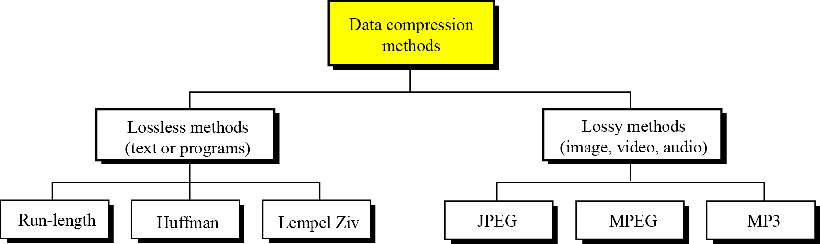
Data compression implies sending or storing a smaller number of bits. Although many methods are used for this purpose, in general these methods can be divided into two broad categories: lossless and lossy methods.

Slide 7
LOSSLESS COMPRESSION
In lossless data compression, the integrity of the data is preserved. The original data and the data after compression and decompression are exactly the same because, in these methods, the compression and decompression algorithms are exact inverses of each other: no part of the data is lost in the process. Redundant data is removed in compression and added during decompression. Lossless compression methods are normally used when we cannot afford to lose any data.

Slide 8
Run-length encoding
Run-length encoding is probably the simplest method of compression. It can be used to compress data made of any combination of symbols. It does not need to know the frequency of occurrence of symbols and can be very efficient if data is represented as 0s and 1s.
The general idea behind this method is to replace consecutive repeating occurrences of a symbol by one occurrence of the symbol followed by the number of occurrences.
The method can be even more efficient if the data uses only two symbols (for example 0 and 1) in its bit pattern and one symbol is more frequent than the other.

Slide 9
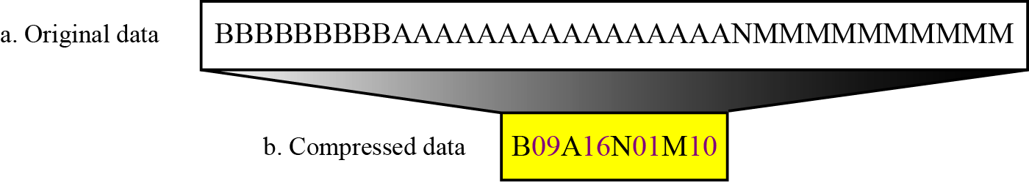

Slide 10
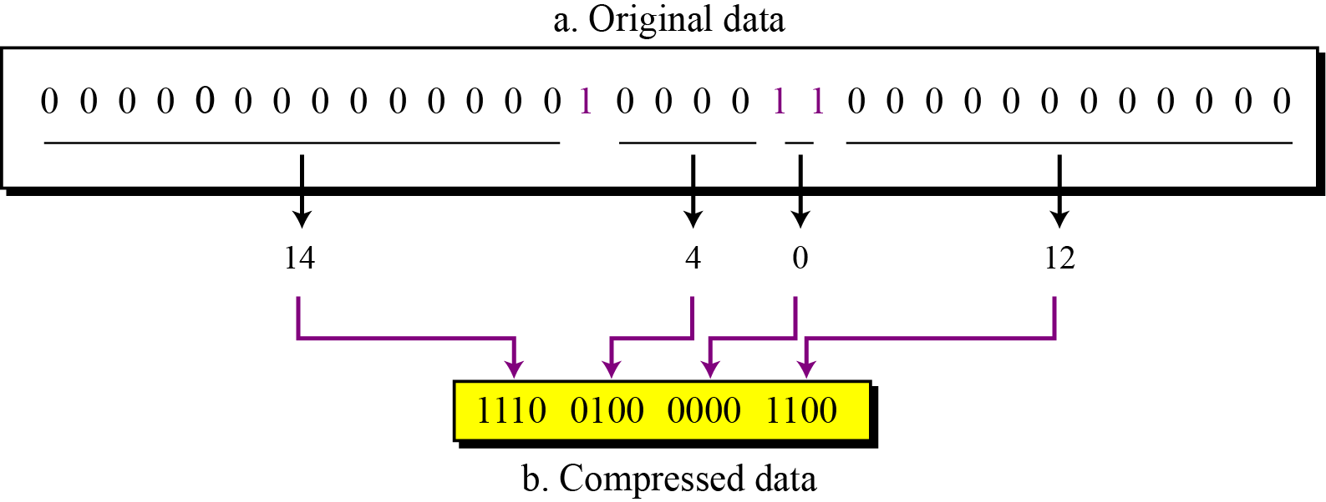
Figure :Run-length encoding for two symbols

Slide 11
Example : 2

Slide 12
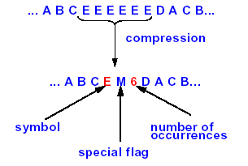
Run-Length Coding
Assumption
  Long sequences of identical symbols
Example

Slide 13
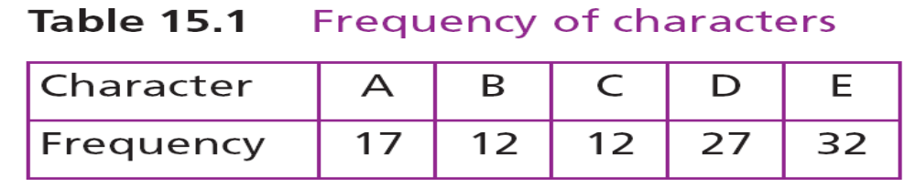
Huffman coding
Huffman coding assigns shorter codes to symbols that occur more frequently and longer codes to those that occur less frequently. For example, imagine we have a text file that uses only five characters (A, B, C, D, E). Before we can assign bit patterns to each character, we assign each character a weight based on its frequency of use. In this example, assume that the frequency of the characters is as shown in Table

Slide 14
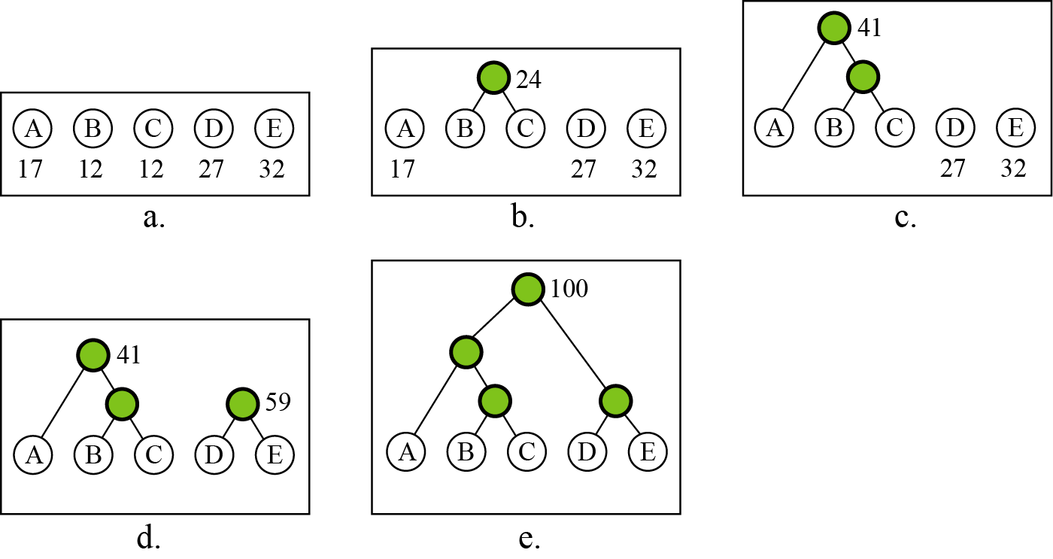
Figure :Huffman coding

Slide 15
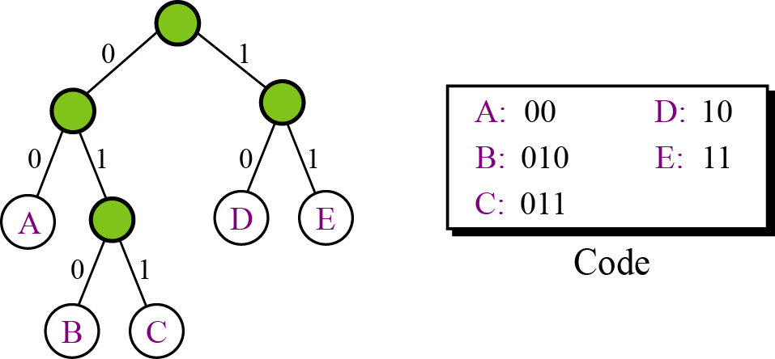
A character’s code is found by starting at the root and following the branches that lead to that character. The code itself is the bit value of each branch on the path, taken in sequence.
Figure :Final tree and code

Slide 16
Example :2

Slide 17
Huffman Coding
Assumption
  Some symbols occur more often than others
  E.g., character frequencies of the English language
Fundamental principle
  Frequently occurring symbols are coded with shorter bit strings

Slide 18
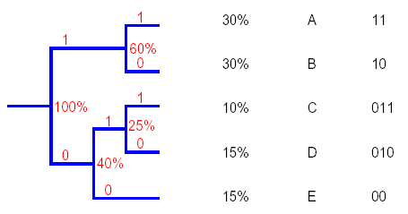
Huffman Coding
Example:
  Characters to be encoded:
    A, B, C, D, E
  Probability to occur:
    p(A)=0.3, p(B)=0.3, p(C)=0.1, p(D)=0.15, p(E)=0.15

Slide 19
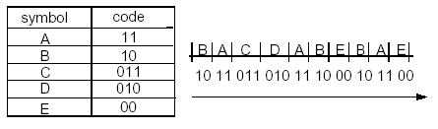
Huffman
Table and example of application to data stream

Slide 20
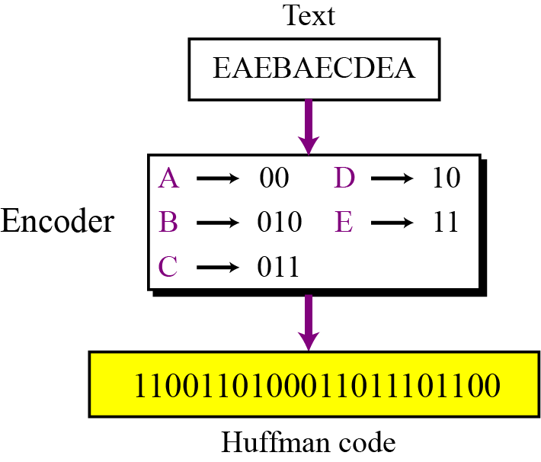
Encoding
Let us see how to encode text using the code for our five characters. Figure, shows the original and the encoded text.
Figure : Huffman encoding

Slide 21
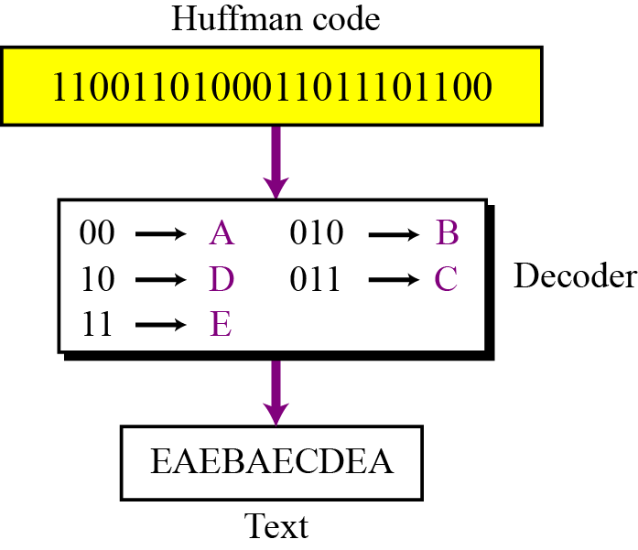
Decoding
The recipient has a very easy job in decoding the data it receives. Figure below, shows how decoding takes place.
Figure : Huffman decoding

Slide 22
Lempel Ziv encoding
Lempel Ziv (LZ) encoding is an example of a category of algorithms called dictionary-based encoding. The idea is to create a dictionary (a table) of strings used during the communication session.
If both the sender and the receiver have a copy of the dictionary, then previously-encountered strings can be substituted by their index in the dictionary to reduce the amount of information transmitted.

Slide 23
Process of Compression
In this phase there are two concurrent events: building an indexed dictionary and compressing a string of symbols. The algorithm extracts the smallest substring that cannot be found in the dictionary from the remaining uncompressed string. It then stores a copy of this substring in the dictionary as a new entry and assigns it an index value. Compression occurs when the substring, except for the last character, is replaced with the index found in the dictionary. The process then inserts the index and the last character of the substring into the compressed string.

Slide 24
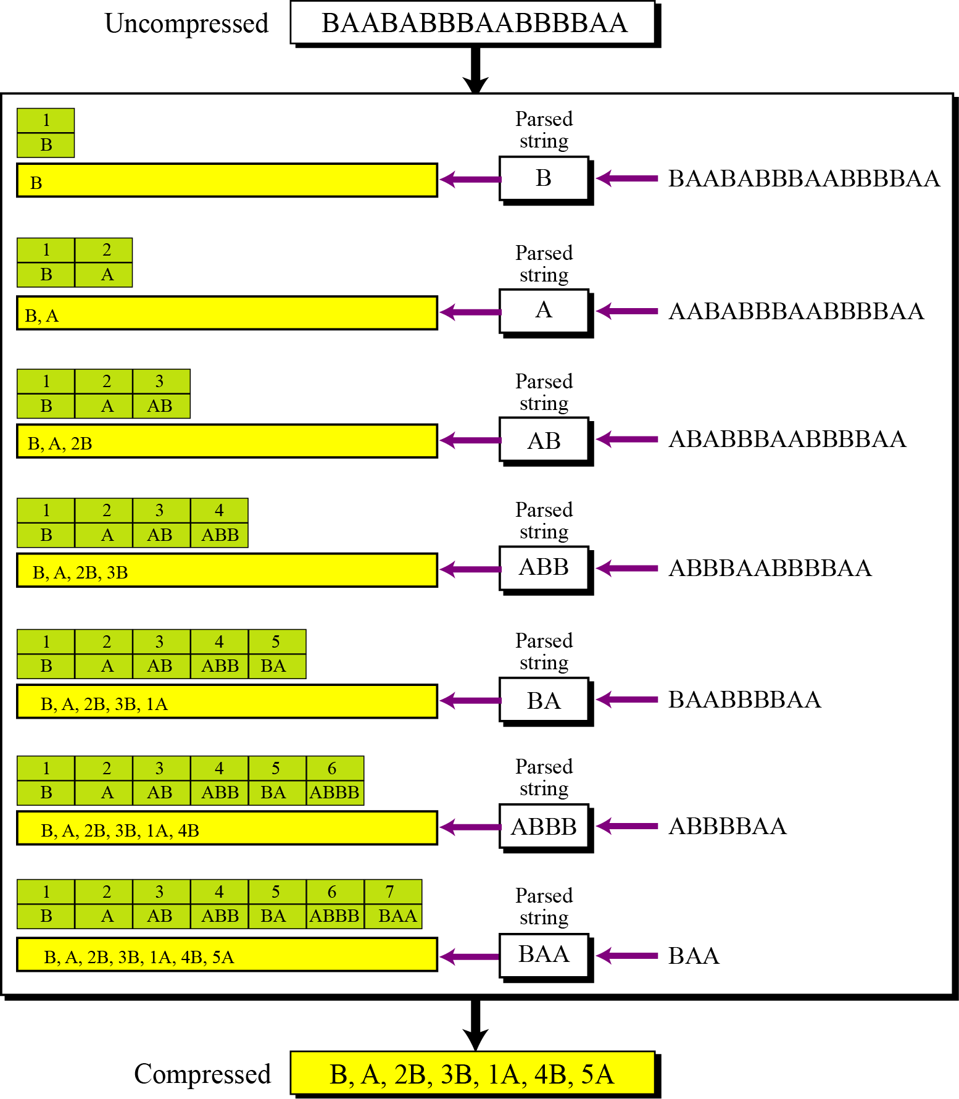
15.<number>
Figure : An example of Lempel Ziv encoding

Slide 25
Decompression
Decompression is the inverse of the compression process. The process extracts the substrings from the compressed string and tries to replace the indexes with the corresponding entry in the dictionary, which is empty at first and built up gradually. The idea is that when an index is received, there is already an entry in the dictionary corresponding to that index.
15.<number>

Slide 26
15.<number>
Figure : An example of Lempel Ziv decoding

Slide 27
15-2 LOSSY COMPRESSION METHODS
Our eyes and ears cannot distinguish subtle changes. In such cases, we can use a lossy data compression method. These methods are cheaper—they take less time and space when it comes to sending millions of bits per second for images and video. Several methods have been developed using lossy compression techniques. JPEG (Joint Photographic Experts Group) encoding is used to compress pictures and graphics, MPEG (Moving Picture Experts Group) encoding is used to compress video, and MP3 (MPEG audio layer 3) for audio compression.
15.<number>

Slide 28
Image compression – JPEG encoding
As discussed in Chapter 2, an image can be represented by a two-dimensional array (table) of picture elements (pixels).
A grayscale picture of 307,200 pixels is represented by 2,457,600 bits, and a color picture is represented by 7,372,800 bits.
In JPEG, a grayscale picture is divided into blocks of 8 × 8 pixel blocks to decrease the number of calculations because, as we will see shortly, the number of mathematical operations for each picture is the square of the number of units.
15.<number>

Slide 29
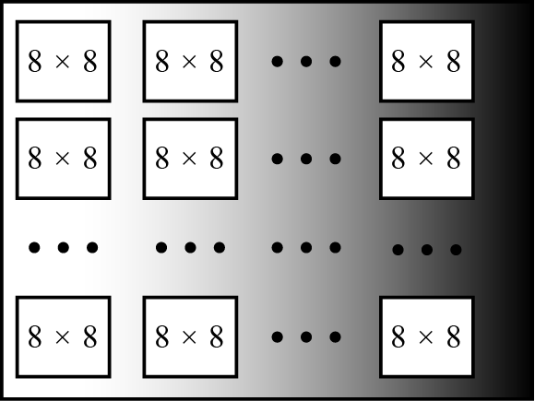
Figure : JPEG grayscale example, 640 × 480 pixels
15.<number>

Slide 30
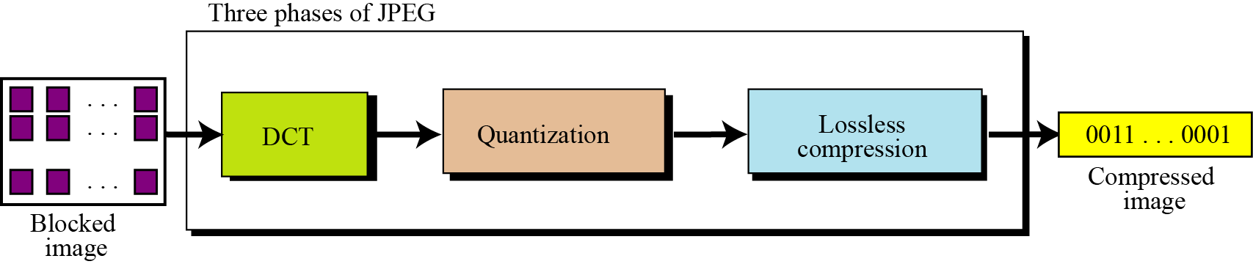
The whole idea of JPEG is to change the picture into a linear (vector) set of numbers that reveals the redundancies. The redundancies (lack of changes) can then be removed using one of the lossless compression methods we studied previously. A simplified version of the process is shown in Figure below.
15.<number>
Figure : The JPEG compression process

Slide 31
Discrete cosine transform (DCT)
In this step, each block of 64 pixels goes through a transformation called the discrete cosine transform (DCT). The transformation changes the 64 values so that the relative relationships between pixels are kept but the redundancies are revealed. The formula is given in Appendix G. P(x, y) defines one value in the block, while T(m, n) defines the value in the transformed block.
15.<number>

Slide 32
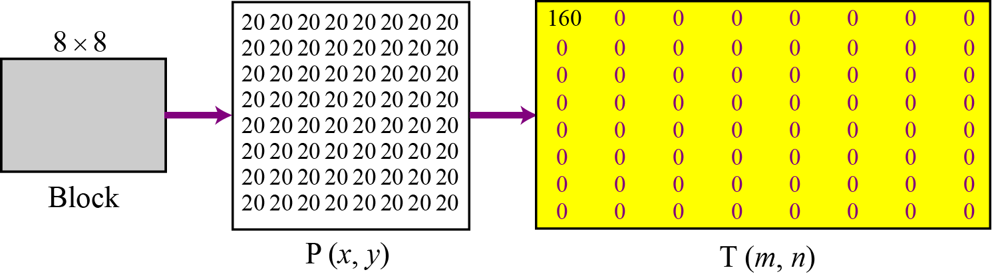
To understand the nature of this transformation, let us show the result of the transformations for three cases.
Figure : Case 1: uniform grayscale

Slide 33
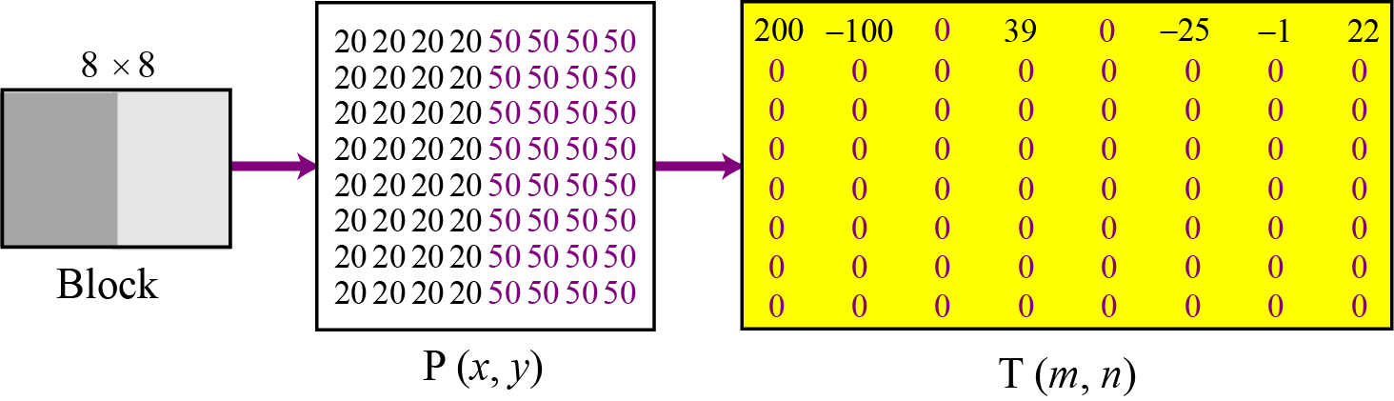
Figure : Case 2: two sections

Slide 34
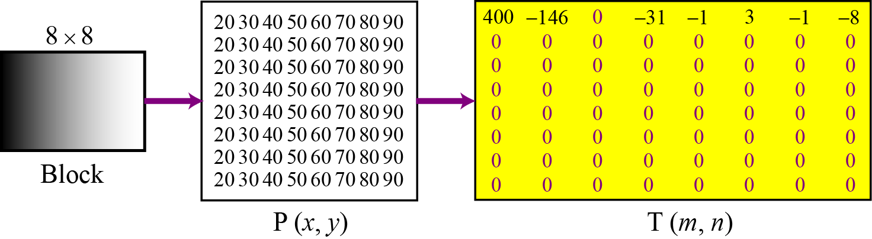
Figure 15.14 Case 3: gradient grayscale
15.<number>

Slide 35
Quantization
After the T table is created, the values are quantized to reduce the number of bits needed for encoding. Quantization divides the number of bits by a constant and then drops the fraction. This reduces the required number of bits even more. In most implementations, a quantizing table (8 by 8) defines how to quantize each value. The divisor depends on the position of the value in the T table. This is done to optimize the number of bits and the number of 0s for each particular application.
15.<number>

Slide 36
Compression
After quantization the values are read from the table, and redundant 0s are removed. However, to cluster the 0s together, the process reads the table diagonally in a zigzag fashion rather than row by row or column by column. The reason is that if the picture does not have fine changes, the bottom right corner of the T table is all 0s.
JPEG usually uses run-length encoding at the compression phase to compress the bit pattern resulting from the zigzag linearization.

Slide 37
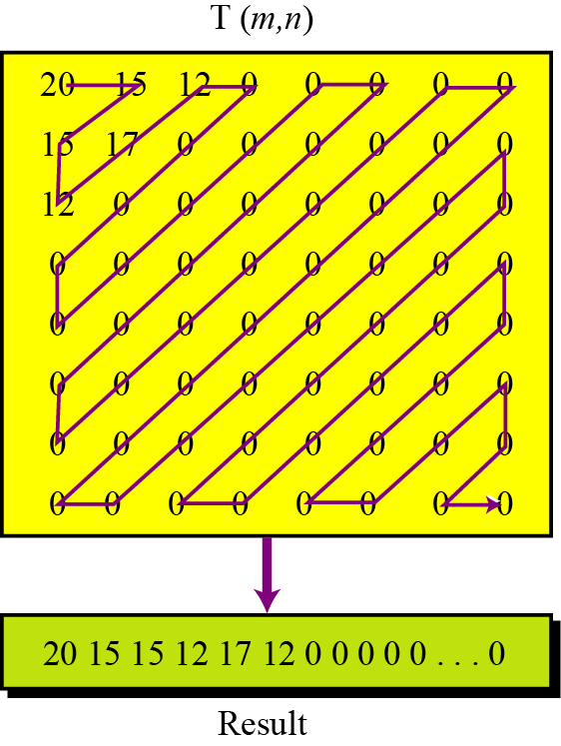
Figure 15.15 Reading the table

Slide 38
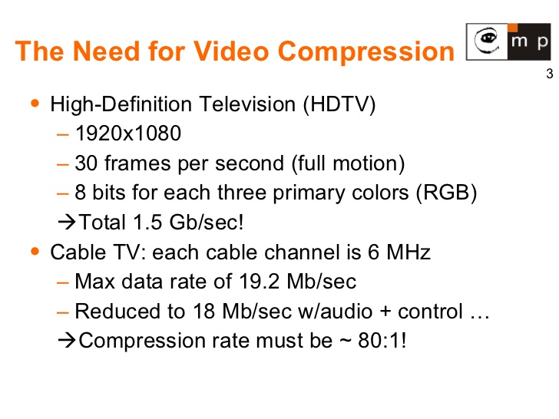
15.<number>

Slide 39
Video compression – MPEG encoding
The Moving Picture Experts Group (MPEG) method is used to compress video. In principle, a motion picture is a rapid sequence of a set of frames in which each frame is a picture. In other words, a frame is a spatial combination of pixels, and a video is a temporal combination of frames that are sent one after another. Compressing video, then, means spatially compressing each frame and temporally compressing a set of frames.

Slide 40
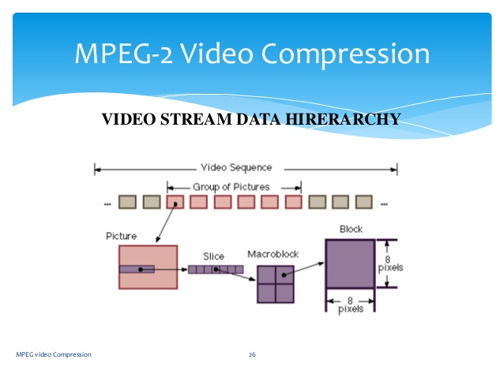
15.<number>

Slide 41
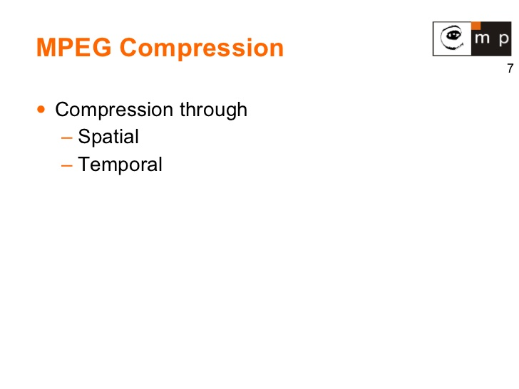
15.<number>

Slide 42
Spatial compression
The spatial compression of each frame is done with JPEG, or a modification of it. Each frame is a picture that can be independently compressed.
Temporal compression
In temporal compression, redundant frames are removed. When we watch television, for example, we receive 30 frames per second. However, most of the consecutive frames are almost the same. For example, in a static scene in which someone is talking, most frames are the same except for the segment around the speaker’s lips, which changes from one frame to the next.

Slide 43
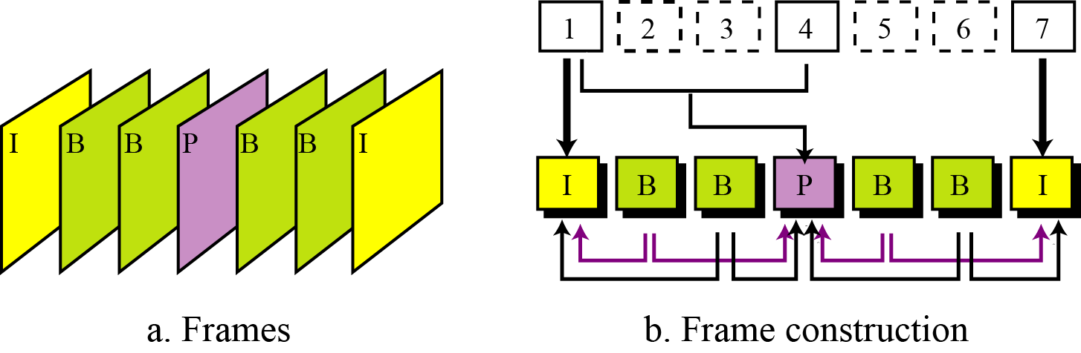
Figure : MPEG frames

Slide 44
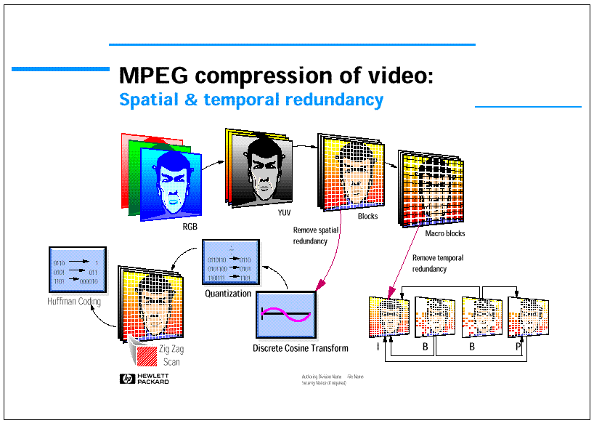
15.<number>

Slide 45
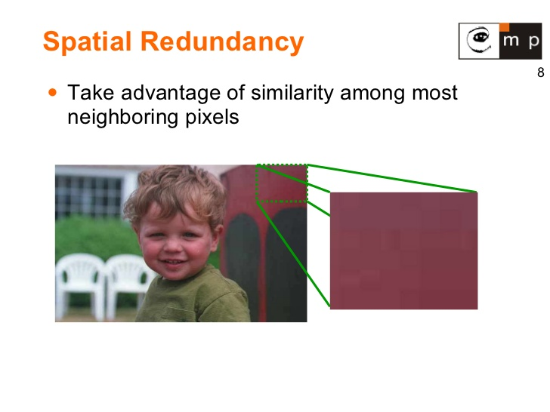
15.<number>

Slide 46
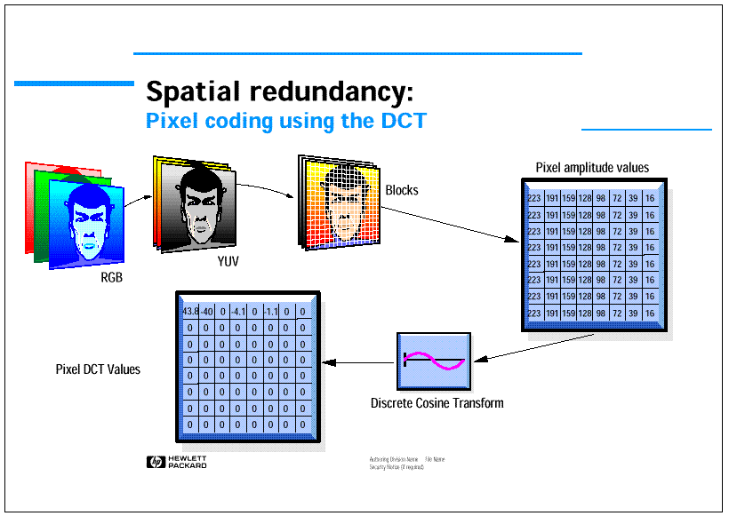
15.<number>

Slide 47
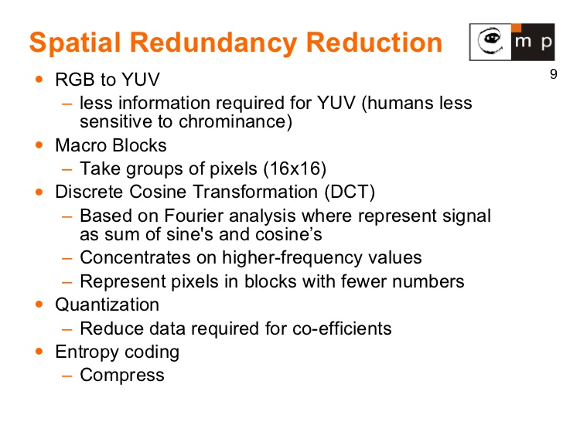
15.<number>

Slide 48
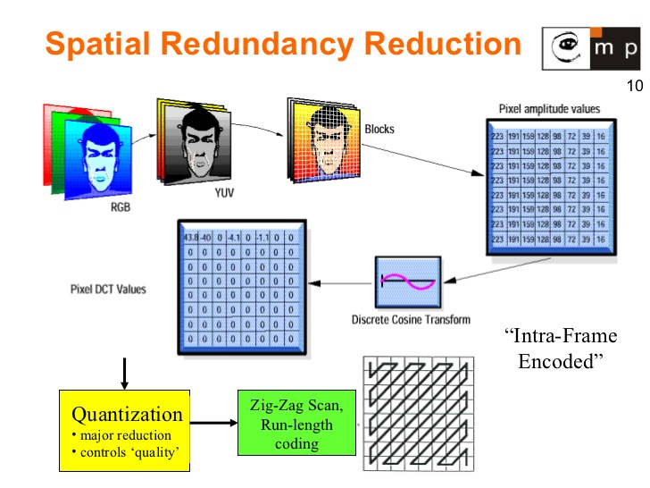
15.<number>

Slide 49
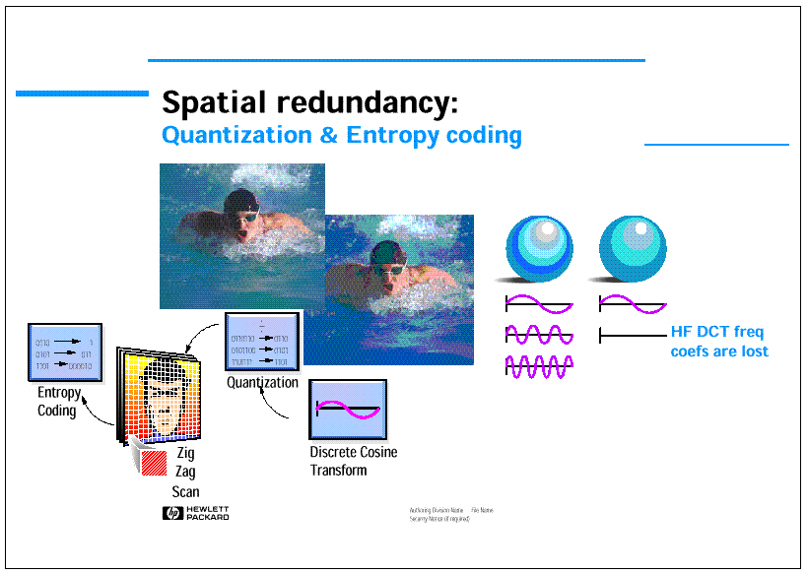
15.<number>

Slide 50
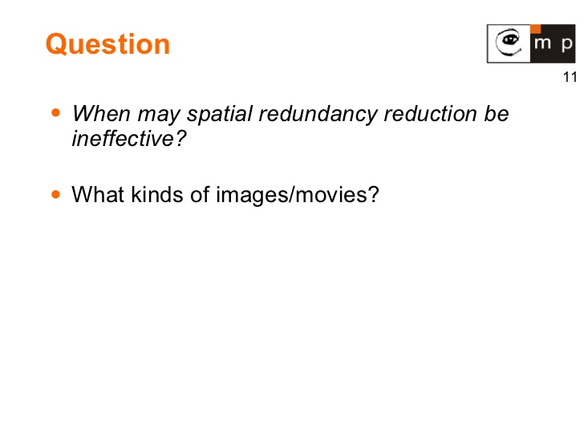
15.<number>

Slide 51
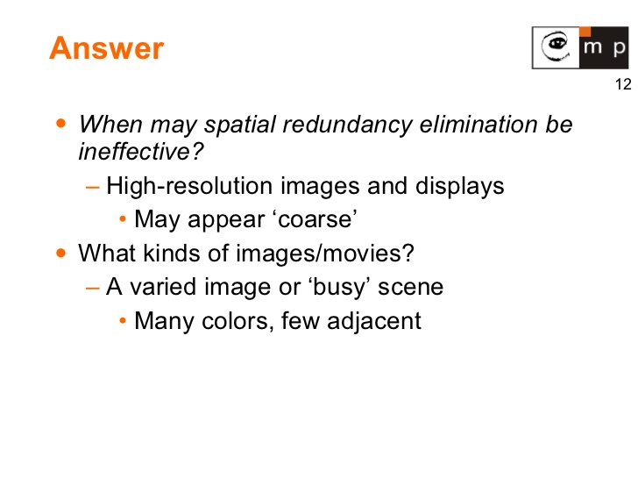
15.<number>

Slide 52
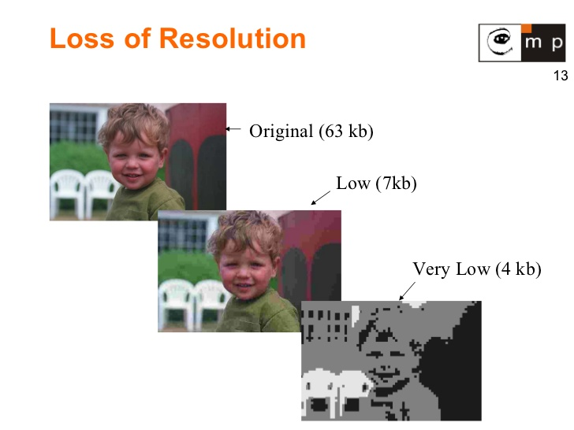
15.<number>

Slide 53
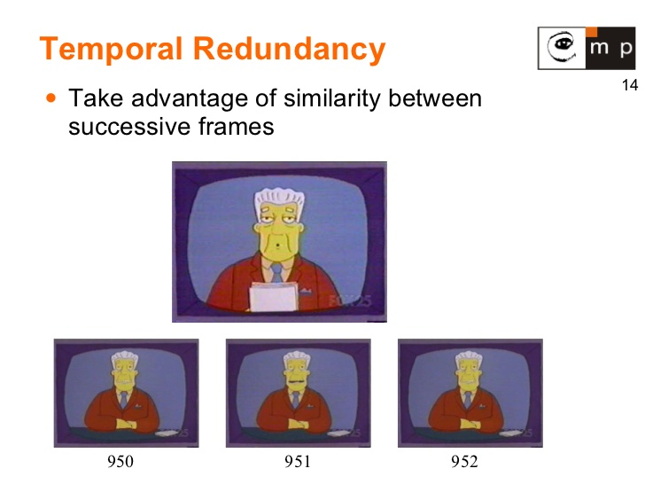
15.<number>

Slide 54
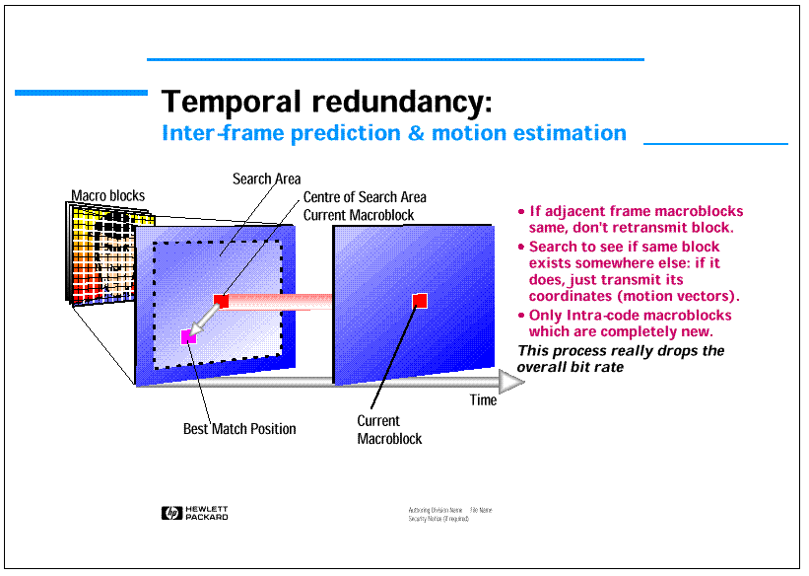
15.<number>

Slide 55
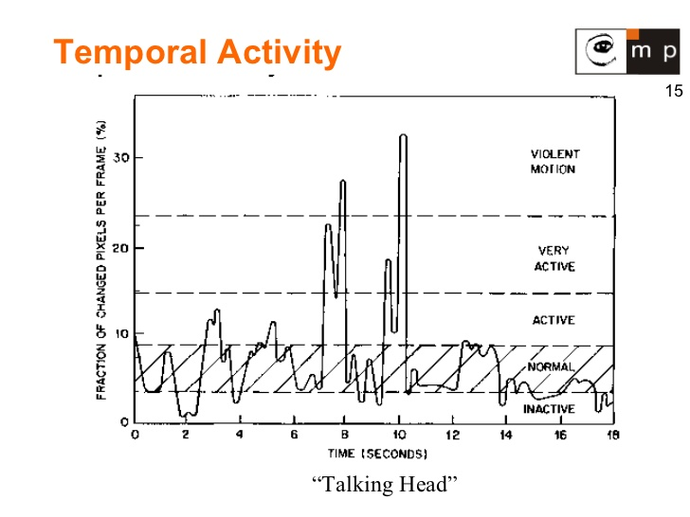
15.<number>

Slide 56
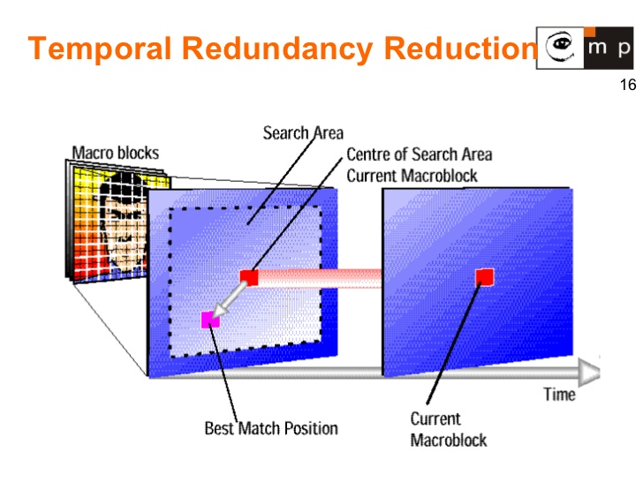
15.<number>

Slide 57
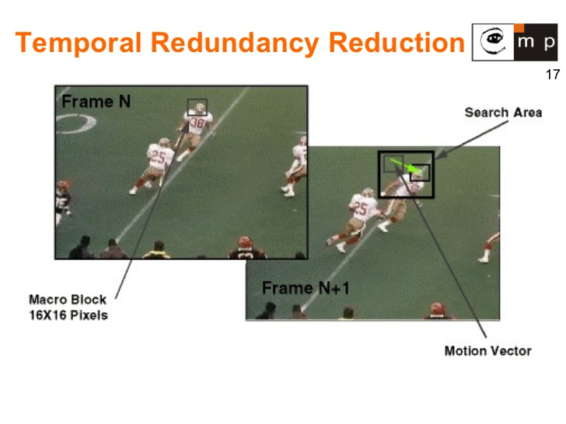
15.<number>

Slide 58
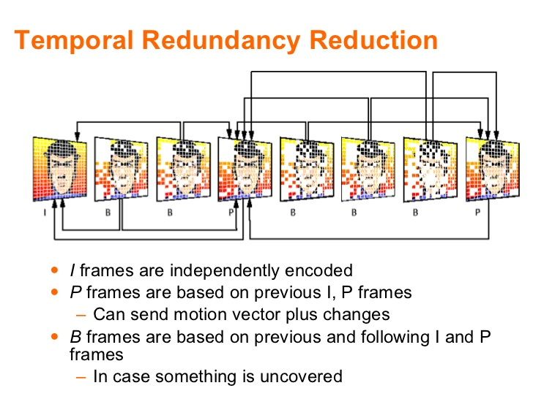
15.<number>

Slide 59
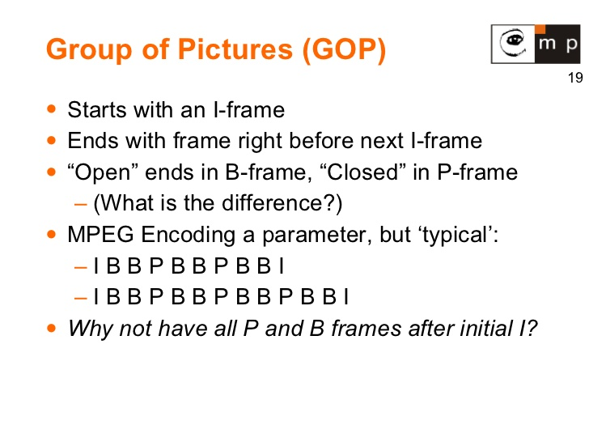
15.<number>

Slide 60
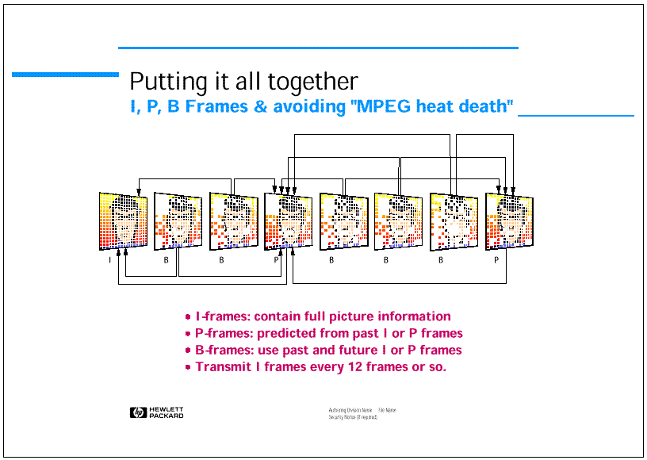
15.<number>

Slide 61
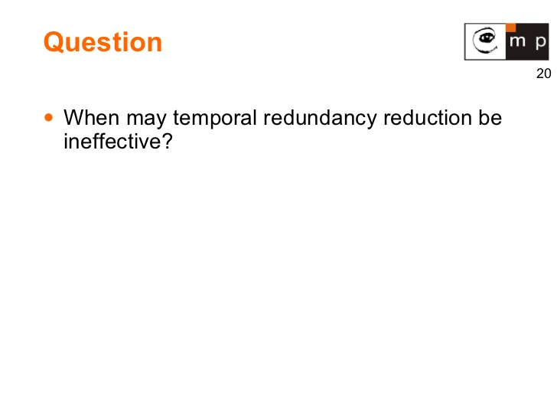
15.<number>

Slide 62
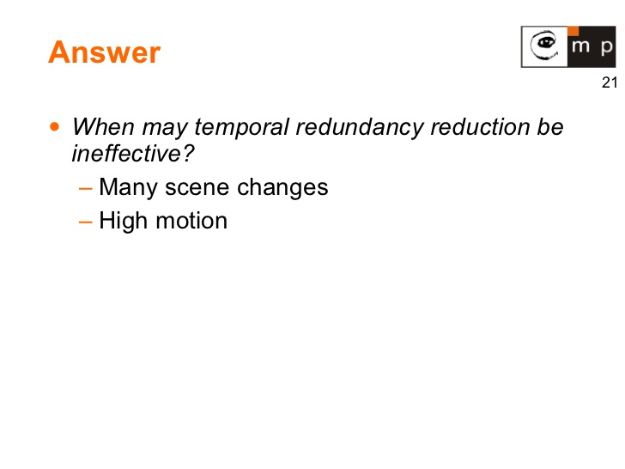
15.<number>

Slide 63
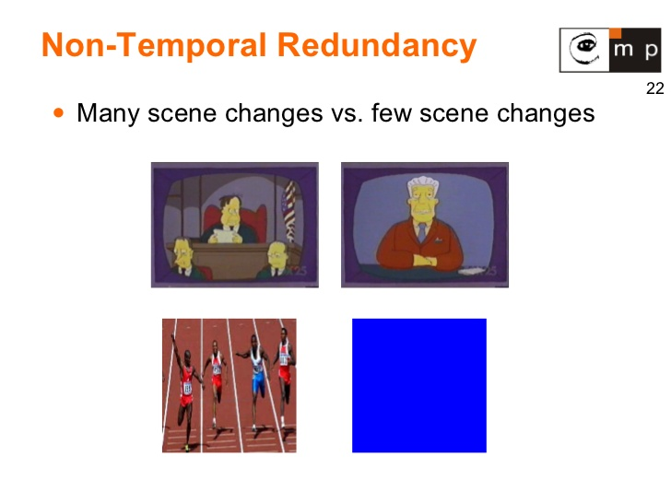
15.<number>

Slide 64
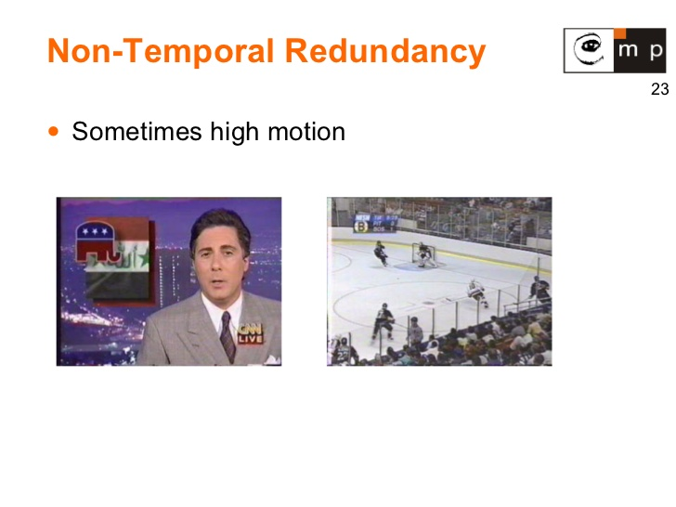
15.<number>

Slide 65
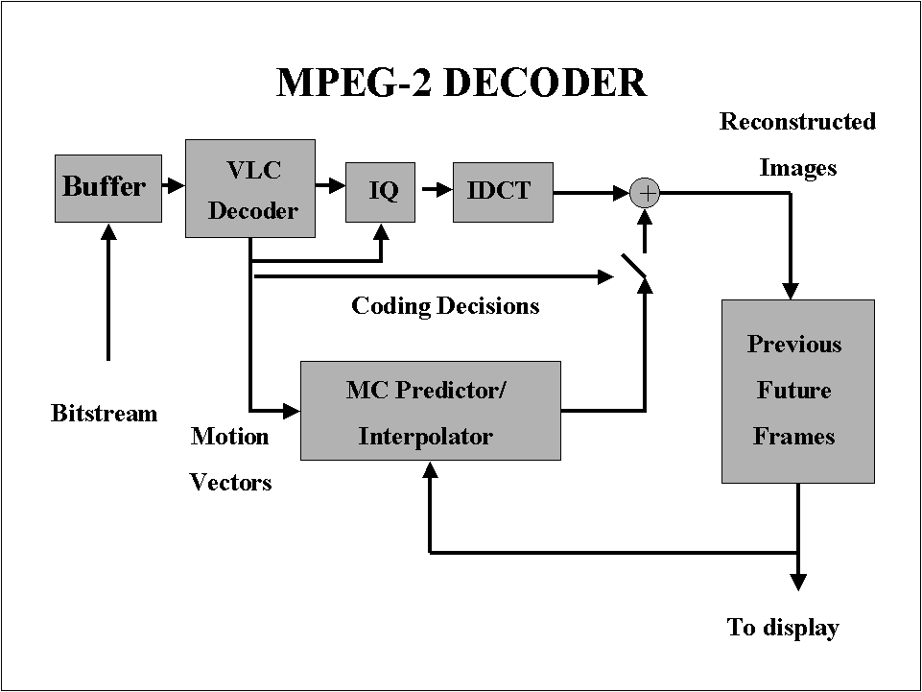
15.<number>

Slide 66
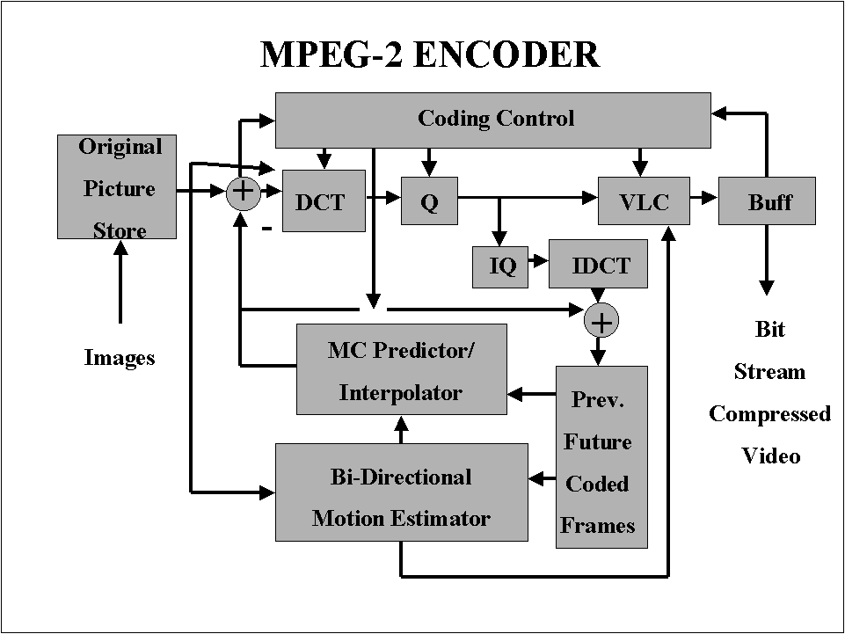
15.<number>

